Slide 1

A practical walkthrough of the supporter experience and the fulfillment tools behind it.
LOCAL PARTNER PRESENTATION
Local partners,
presented with purpose.
Controlled application walkthrough
Illustrative profiles only
Denver Metro + Boulder corridor
Availability confirmed during onboarding
Notes:
Open by positioning this as a product walkthrough, not a case study.
Explain that the names, storefronts, orders, and reports shown are controlled illustrative profiles, not signed or active partners.
Set the meeting objective: understand the supporter experience, the Local Partner workflow, and what onboarding would require.
[Sources]
- C:/Users/bwelk/OneDrive/Desktop/APPS/LocalLoop_Local_Partner_Deck/01_brief/approved_claims.md
- C:/Users/bwelk/OneDrive/Desktop/APPS/LocalLoop_Local_Partner_Deck/02_brand/brand_reference/working_presentation_style.md
[/Sources]

Slide 2
How the LocalLoop model works
02
A coordinated loop with clear responsibilities at every step.
01
02
03
04
Organization
Supporters
Local Partner
Organization
Launches a fundraiser
Order online
Fulfills its products
Handles final distribution
LocalLoop provides the shared operating layer
Storefront Software • Order Records • Fulfillment Reports • Coordination + Technical Support
Online fundraiser pages + reports are the source of truth
Notes:
Walk left to right and keep the roles precise.
Local Partners fulfill their own products. The fundraising organization handles supporter pickup or final distribution.
LocalLoop supplies the shared software, order records, reports, coordination support, and technical support; it does not warehouse or distribute products.
[Sources]
- C:/Users/bwelk/OneDrive/Desktop/APPS/LocalLoop_Local_Partner_Deck/01_brief/approved_claims.md
[/Sources]

Slide 3
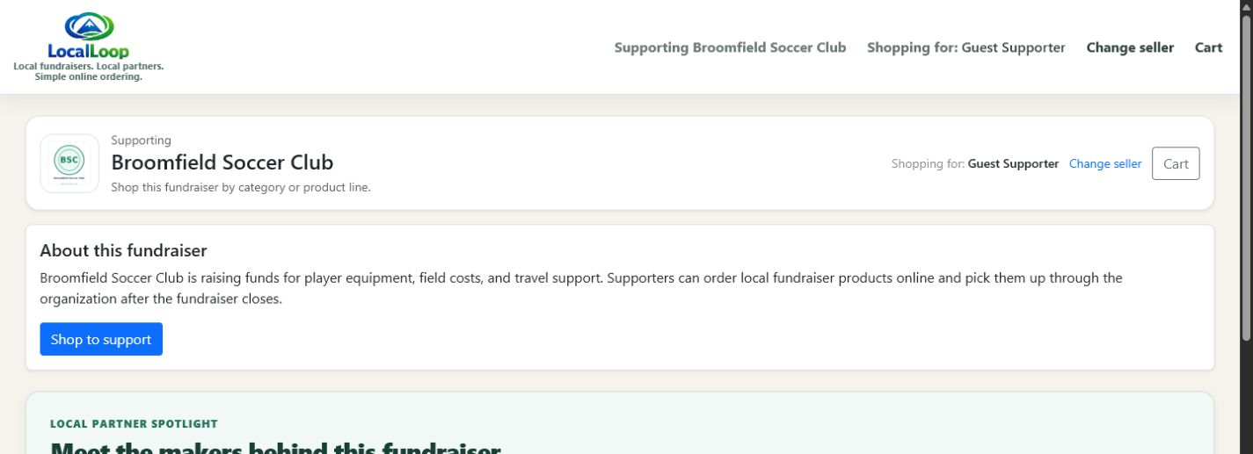
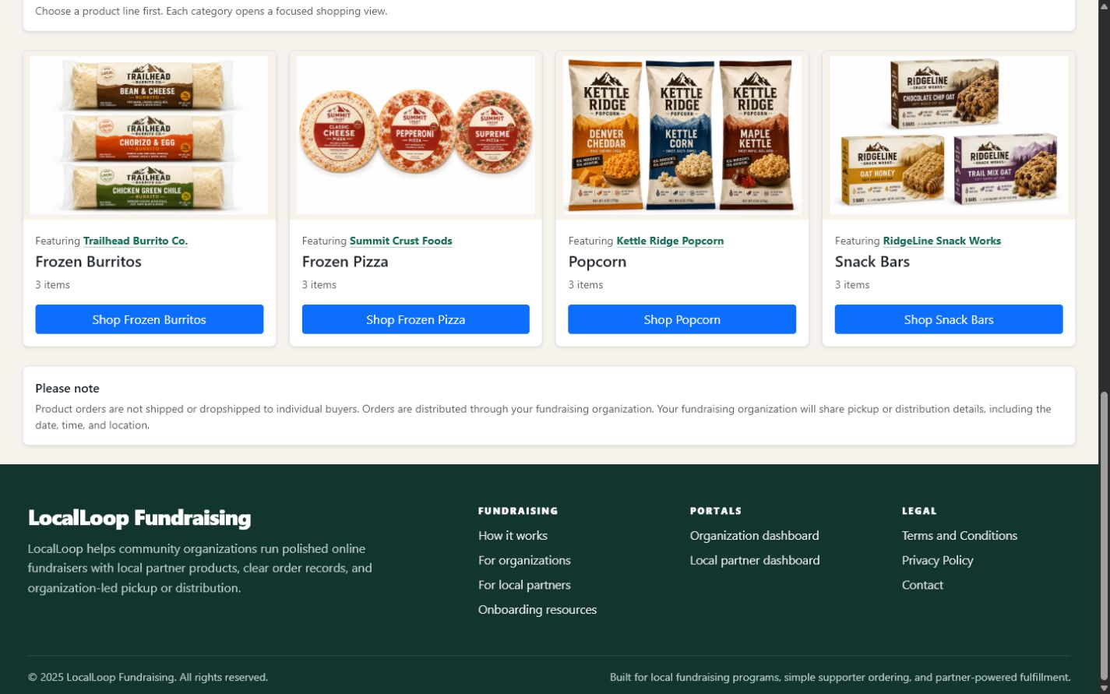
The supporter storefront
03
FUNDRAISER ENTRY
Fundraiser context comes first.
1
See the cause
Organization identity and story frame the purchase.
2
Browse quickly
Product lines make a larger catalog approachable.
PRODUCT LINES
3
Know the handoff
Pickup and distribution expectations stay visible.
Illustrative controlled showing profile · not an active partnership
Notes:
Point out what a supporter sees first: the fundraising organization, why it is raising funds, and the available product lines.
The supporter selects a category and shops within the context of the fundraiser rather than a generic marketplace.
The page also sets expectations that orders are distributed through the organization.
[Sources]
- C:/Users/bwelk/OneDrive/Desktop/APPS/LocalLoop_Local_Partner_Deck/03_screenshots/buyer_storefront/01_storefront_hero_categories.png
- C:/Users/bwelk/OneDrive/Desktop/APPS/LocalLoop_Local_Partner_Deck/03_screenshots/buyer_storefront/01b_storefront_categories.png
- C:/Users/bwelk/OneDrive/Desktop/APPS/LocalLoop_Local_Partner_Deck/01_brief/approved_claims.md
[/Sources]

Slide 4
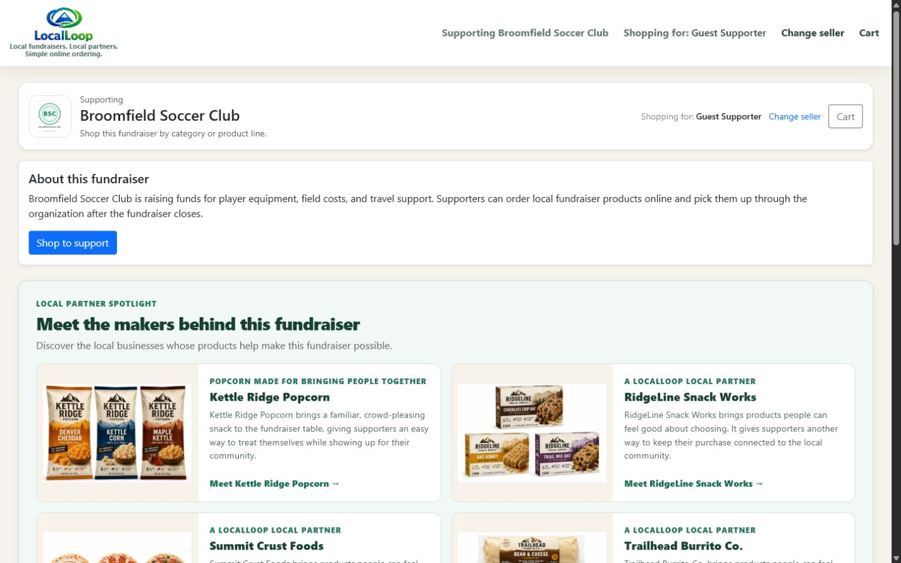
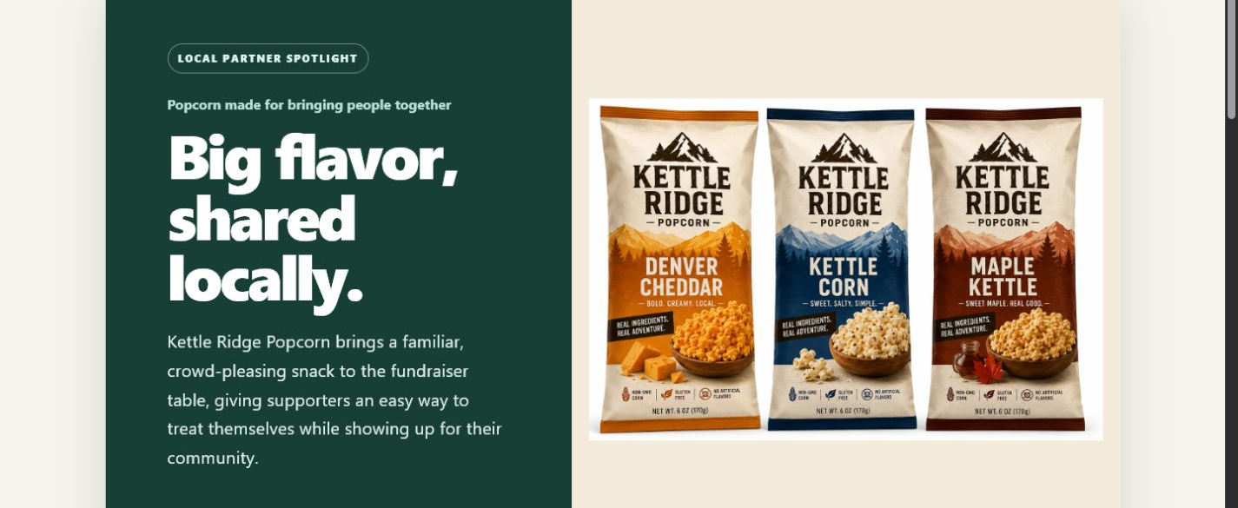
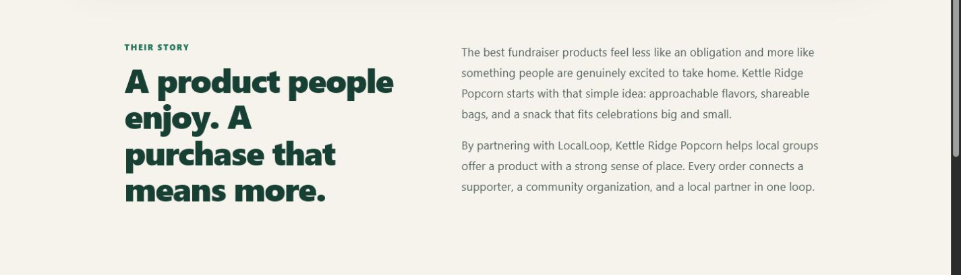
More than a product listing: Local Partner stories
04
Discovery in the fundraiser storefront opens into a dedicated brand and product story.
DISCOVER
GO DEEPER
Visibility • Identity • Product Story • Community Connection
Kettle Ridge Popcorn is an illustrative controlled profile, not an active Local Partner
Notes:
Treat this as a major value proposition, not a minor storefront feature.
Start on the left: participating Local Partners can receive visibility inside applicable fundraiser storefronts.
Move to the right: the dedicated profile gives the business room to present its identity, product story, and community connection professionally.
Be explicit that Kettle Ridge Popcorn is a controlled illustrative profile, not a signed or active Local Partner.
[Sources]
- C:/Users/bwelk/OneDrive/Desktop/APPS/LocalLoop_Local_Partner_Deck/03_screenshots/buyer_storefront/02_local_partner_spotlight.png
- C:/Users/bwelk/OneDrive/Desktop/APPS/LocalLoop_Local_Partner_Deck/03_screenshots/buyer_storefront/03_kettle_ridge_partner_story.png
- C:/Users/bwelk/OneDrive/Desktop/APPS/LocalLoop_Local_Partner_Deck/03_screenshots/buyer_storefront/04_kettle_ridge_their_story.png
[/Sources]

Slide 5
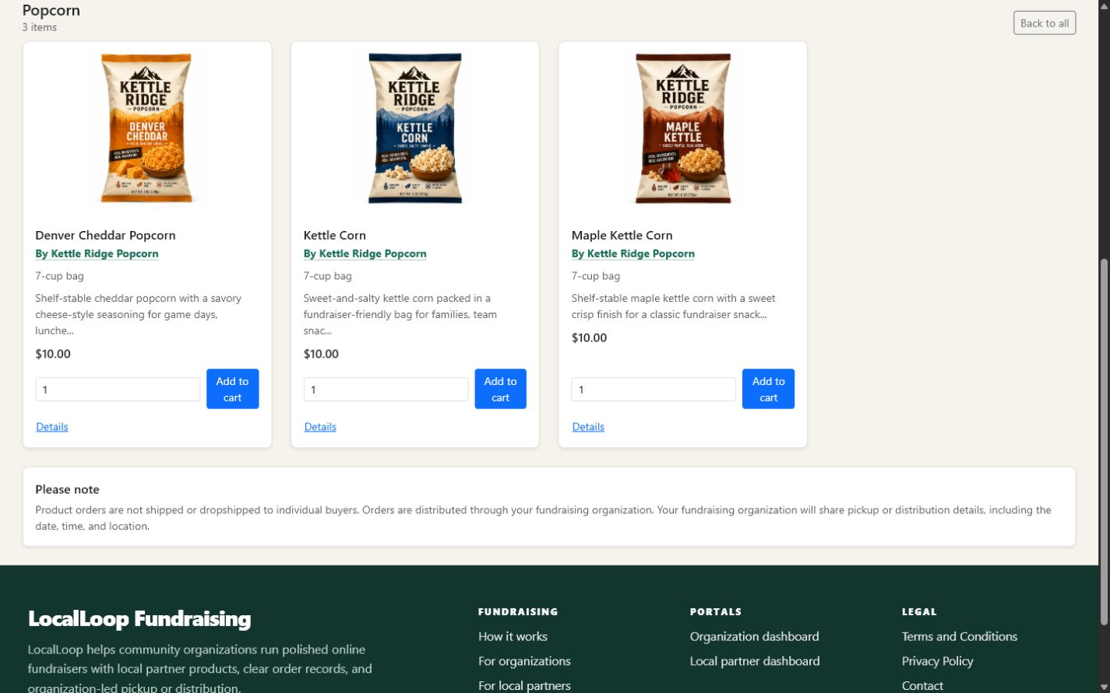
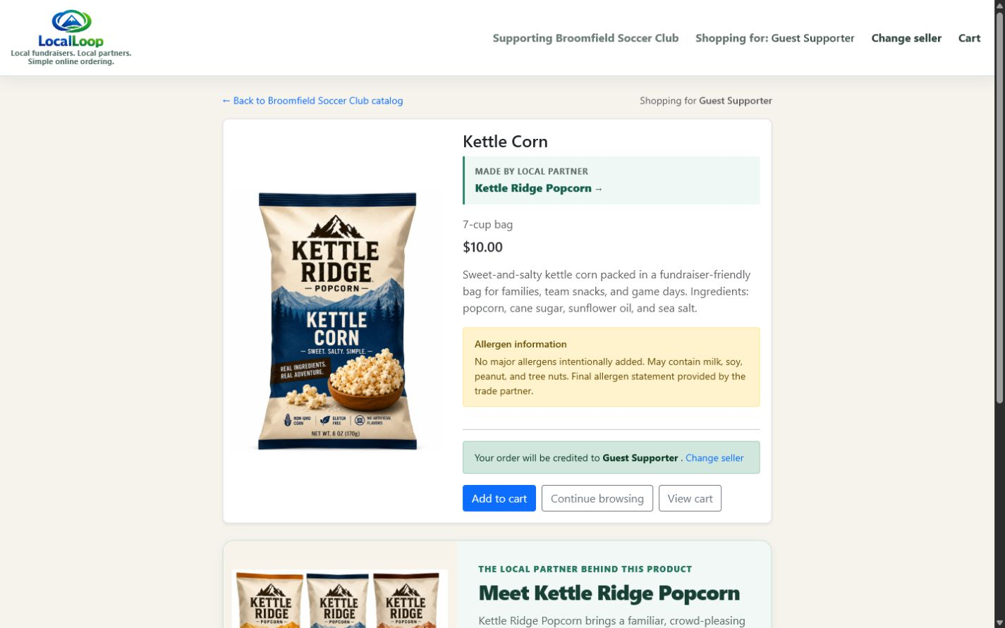
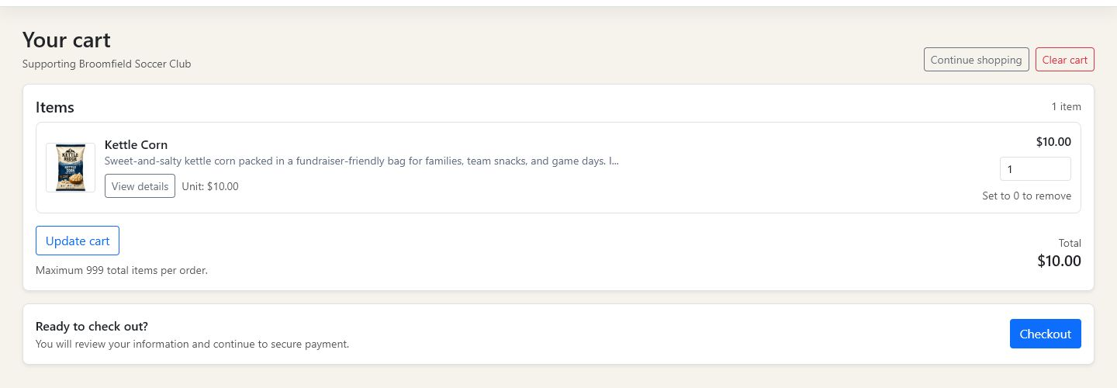
The supporter ordering experience
05
1 BROWSE
2 REVIEW
3 CART + CHECKOUT
A clear path from product discovery to purchase, all inside the fundraiser context.
Illustrative controlled showing profile · not an active partnership
Notes:
Use the three screens as a simple journey: browse a product line, review the product details, then confirm the cart.
Point out Local Partner attribution, package size, price, description, allergen information, and the add-to-cart action.
The walkthrough stops before entering payment or buyer information.
[Sources]
- C:/Users/bwelk/OneDrive/Desktop/APPS/LocalLoop_Local_Partner_Deck/03_screenshots/buyer_storefront/05_popcorn_product_grid.png
- C:/Users/bwelk/OneDrive/Desktop/APPS/LocalLoop_Local_Partner_Deck/03_screenshots/buyer_storefront/06_kettle_corn_product_detail.png
- C:/Users/bwelk/OneDrive/Desktop/APPS/LocalLoop_Local_Partner_Deck/03_screenshots/buyer_storefront/07b_populated_cart_crop.png
[/Sources]

Slide 6
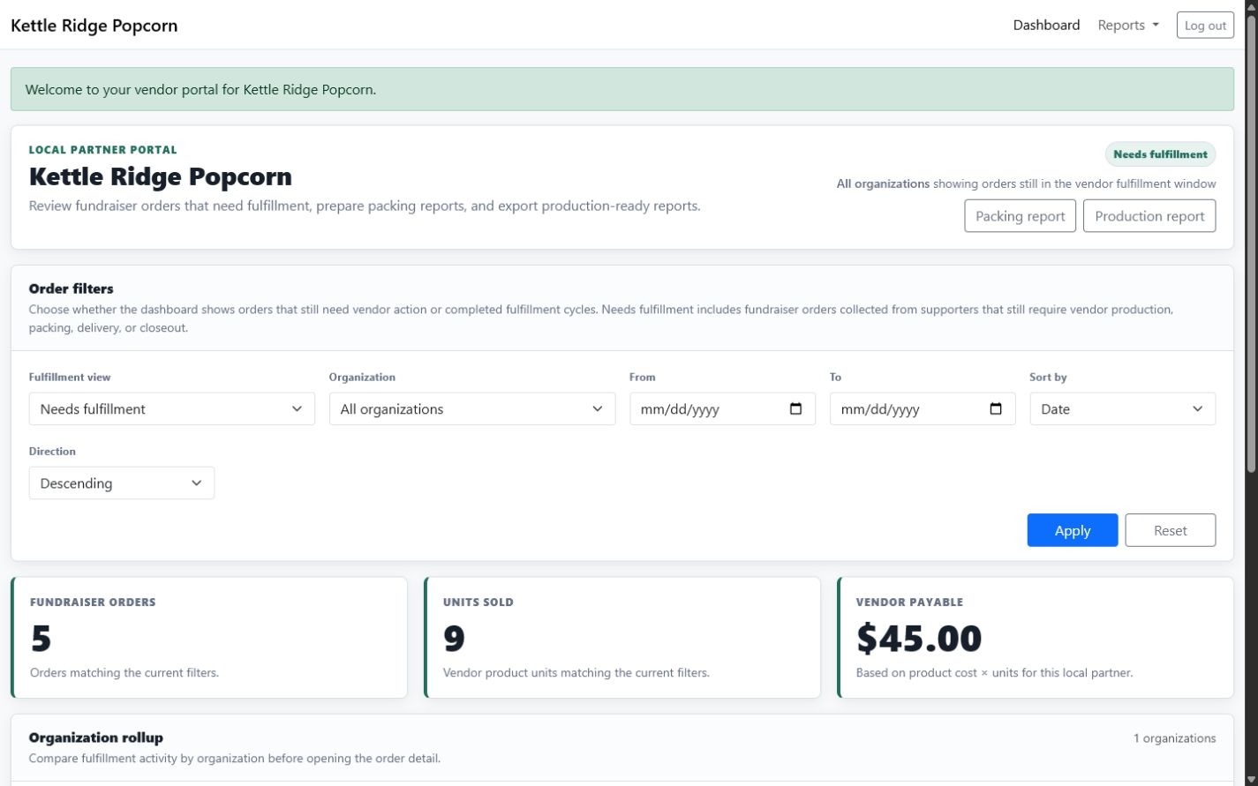
The Local Partner portal
06
One operational home for fulfillment.
1
Filter
Focus on orders that still need action.
2
Understand
See order, unit, and payable estimates.
3
Export
Open production and packing reports.
Illustrative controlled showing profile · not an active partnership
Notes:
Explain that this is the Local Partner’s operational home for orders that need fulfillment.
The filters narrow the view; the KPI row summarizes the current selection; the two report buttons support production and packing.
The displayed values are controlled showing data and should not be described as actual sales or business performance.
[Sources]
- C:/Users/bwelk/OneDrive/Desktop/APPS/LocalLoop_Local_Partner_Deck/03_screenshots/local_partner_portal/08_kettle_ridge_dashboard.png
- C:/Users/bwelk/OneDrive/Desktop/APPS/LocalLoop_Local_Partner_Deck/01_brief/approved_claims.md
[/Sources]

Slide 7
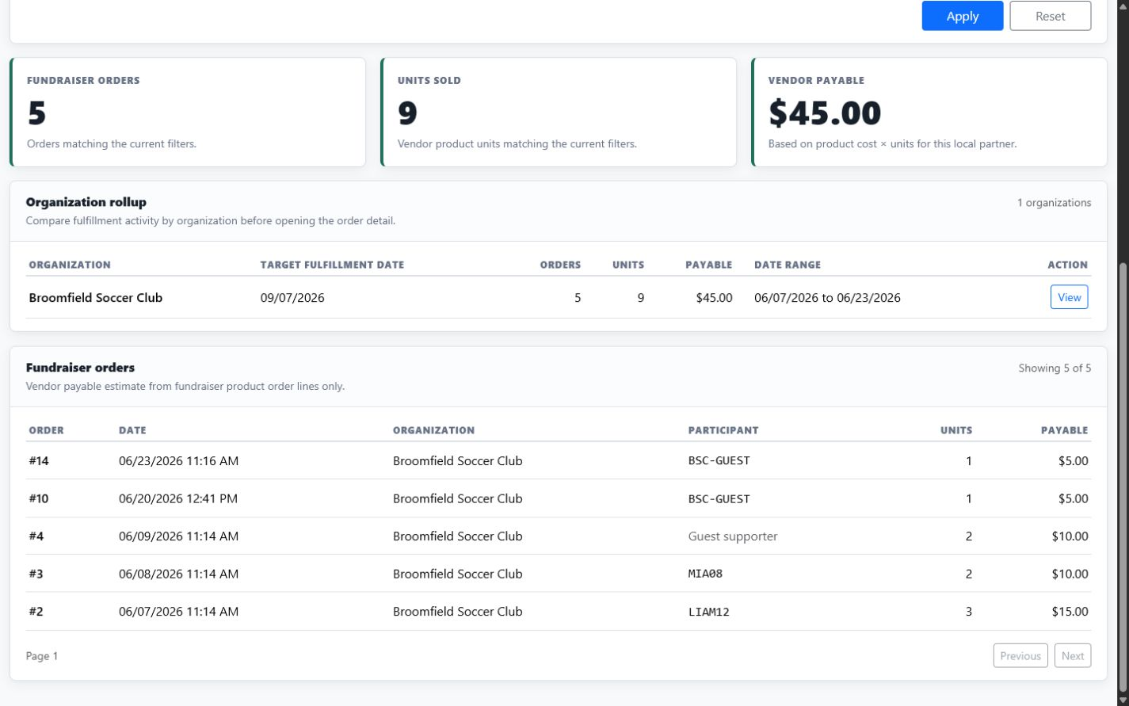
Current fundraiser and order activity
07
CONTROLLED SHOWING DATA
A focused view answers three practical questions:
1
When?
Target fulfillment date and activity range.
2
How much?
Orders and product units in the selected view.
3
Which orders?
Order-level records for fulfillment follow-through.
Illustrative controlled showing profile · not an active partnership
Notes:
This screenshot is filtered to the controlled Broomfield Soccer Club profile.
Show how the rollup and order detail answer when fulfillment is due, how many units are involved, and which order records make up the total.
Do not present the quantities or payable amounts as real activity or achieved results.
[Sources]
- C:/Users/bwelk/OneDrive/Desktop/APPS/LocalLoop_Local_Partner_Deck/03_screenshots/local_partner_portal/09_broomfield_order_activity.png
[/Sources]

Slide 8
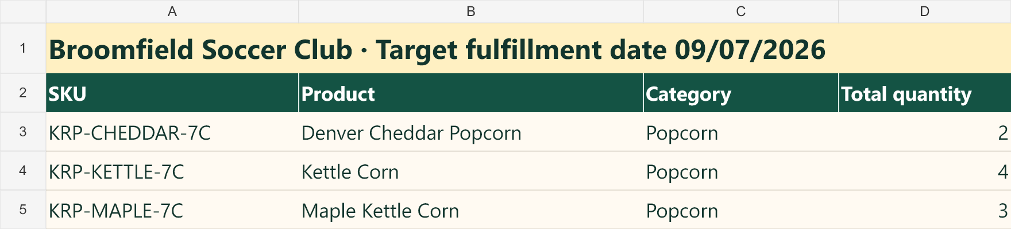
Production reporting
08
Consolidated quantities turn storefront orders into a clear preparation view.
01
02
03
Consolidated
Production-ready
Source of truth
One quantity by SKU and product.
A focused view for preparation or production.
Built from online fundraiser order records.
Local Partners fulfill their own products
Notes:
Explain that the production report consolidates the selected fundraiser orders by SKU, product, category, and total quantity.
A Local Partner can use this view to prepare or produce the required quantities.
Online fundraiser pages and LocalLoop reports serve as the source of truth for fundraiser orders.
[Sources]
- C:/Users/bwelk/OneDrive/Desktop/APPS/LocalLoop_Local_Partner_Deck/03_screenshots/local_partner_portal/10_production_report.png
- C:/Users/bwelk/OneDrive/Desktop/APPS/LocalLoop_Local_Partner_Deck/01_brief/approved_claims.md
[/Sources]

Slide 9
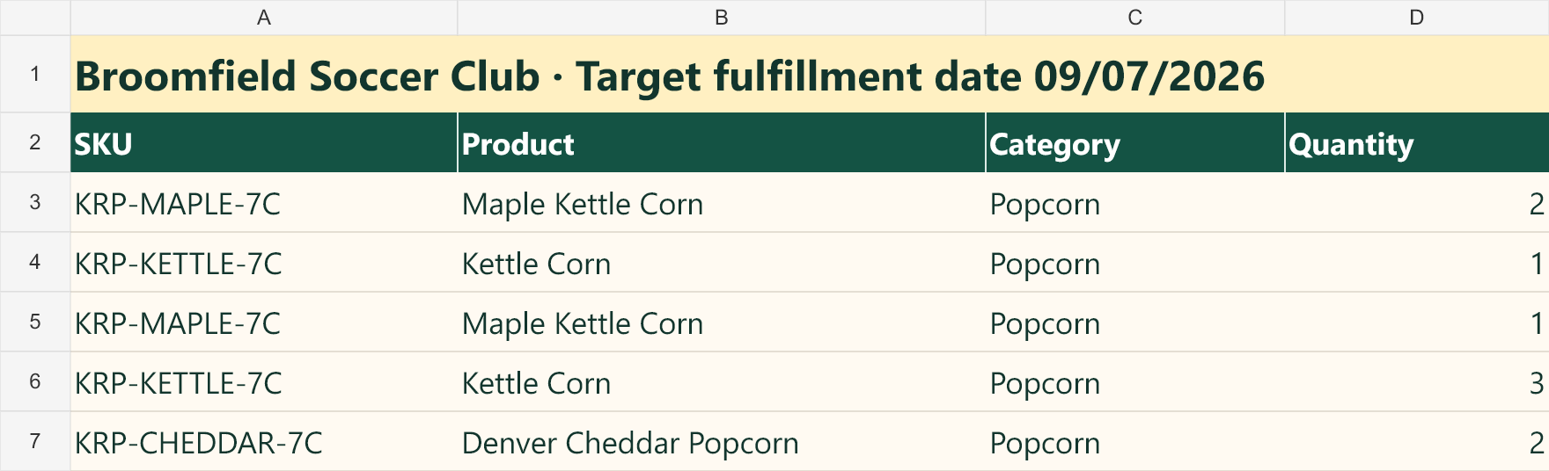
Packing and fulfillment
09
Packing detail supports an organized handoff without changing who owns fulfillment.
Local Partner
Organized handoff
Organization
Packs and fulfills its products
Report detail keeps quantities clear
Handles final-mile distribution
Presentation view sanitized: no addresses, participant names, or customer names
Notes:
This is a sanitized presentation view of the packing report. Address and participant/customer fields were removed from the visual.
Use the flow to reinforce ownership: the Local Partner packs and fulfills its products; the organization handles final-mile supporter distribution.
LocalLoop supports the information flow and provides the report. It does not warehouse or transport products.
[Sources]
- C:/Users/bwelk/OneDrive/Desktop/APPS/LocalLoop_Local_Partner_Deck/03_screenshots/local_partner_portal/11_packing_report_sanitized.png
- C:/Users/bwelk/OneDrive/Desktop/APPS/LocalLoop_Local_Partner_Deck/01_brief/approved_claims.md
[/Sources]

Slide 10
Onboarding and next steps
A focused conversation turns product fit into an operating plan.
01
Product fit + pricing
Agree on the product lineup, pricing, and fundraising program details.
02
Information + images
Provide approved product and brand presentation materials.
03
Fulfillment expectations
Confirm availability, timing, preparation, and handoff responsibilities.
04
Access + support
LocalLoop sets up the Local Partner portal. From there, you access reports, fundraiser activity, and support.
Next conversation
Confirm fit, availability, and the first onboarding step.
Denver Metro + Boulder corridor · availability confirmed during onboarding
Notes:
Close by turning the discussion into four practical onboarding topics rather than promising a fixed timeline.
Confirm product selection and pricing inputs, approved product information and images, fulfillment expectations, and portal/report access.
LocalLoop currently supports fundraisers in the Denver Metro area and Boulder corridor, with availability confirmed during onboarding.
Ask which topic needs clarification before agreeing on the next conversation.
[Sources]
- C:/Users/bwelk/OneDrive/Desktop/APPS/LocalLoop_Local_Partner_Deck/01_brief/approved_claims.md
- C:/Users/bwelk/OneDrive/Desktop/APPS/LocalLoop_Local_Partner_Deck/01_brief/deck_content_notes.md
[/Sources]

